Slide 1
Practice quiz

Slide 2
Interruption of nerve to stapedius muscle would cause this symptom
HYPERACUSIS

Slide 3
The facial nerve canal is also known as canal of ----------------
FALLOPIUS

Slide 4
The sensory component of facial nerve is called nervus
INTERMEDIUS

Slide 5
Arterial blood supply of trachea in its cranial half comes from _ _ _ _ _ _ _ _ _ _ _ _ _ _ _ vessels
INFERIOR THYROID

Slide 6
The upper free edge of this membrane forms vocal ligament
Conus Elasticus

Slide 7
This muscle increases decreases frequency of vocal cord vibration.
Thyroarytenoid

Slide 8
The sign elicited by to and fro movements of larynx over vertebral bodies.
Laryngeal Crepitus

Slide 9
Only unpaired intrinsic muscle of larynx
Transverse Arytenoid

Slide 10
Only abductor muscle of vocal cords
POSTERIOR CRICOARYTENOID

Slide 11
This lymph node drains vocal cord
DELPHIAN

Slide 12
Narrowest portion of infant's larynx
SUBGLOTTIS

Slide 13
Externally placed intrinsic muscle of larynx.
CRICOTHYROID

Slide 14
This recurrent laryngeal nerve is more to be injured during neck trauma
RIGHT

Slide 15
Subglottis develops from this branchial arch.
SIXTH

Slide 16
The first intratemporal branch of facial nerve is greater _________
PETROSAL

Slide 17
This artery is one of the three principal arteries of facial nerve
SUPERIOR PETROSAL

Slide 18
The chorda tympani exits tympanic cavity via canal of ________ and petrotympanic fissure.
HUGUIER

Slide 19
This segment is the most frequent site of facial canal dehiscence
HORIZONTAL

Slide 20
The motor nucleus of facial nerve lies in caudal _____
PONS

Slide 21
The taste fibers of facial nerve convey taste sensation from the anterior ___ _____of the tongue
TWO-THIRD

Slide 22
This is the narrowest and shortest segment of facial nerve canal.
LABYRINTHINE

Slide 23
Upward rolling of eye on the side of paralysis upon attempted closure of eye in a patient with complete interruption of facial nerve is called _______ phenomena
BELL’S

Slide 24
The sensory component of facial nerve is also known as nerve of _______
WRISBERG

Slide 25
Facial nerve innervates structures that are derived from this embryonic cartilage.
REICHERTS

Slide 26
Tracheostomy is indicated in a patient with respiratory failure when his vital capacity falls to _ _ _ _ _ _ _ _ _ _ percent of normal value
TWENTY-FIVE

Slide 27
The posterior wall of trachea is connected for its whole length with_ _ _ _ _ _ _ _ _ _
OESOPHAGUS

Slide 28
Post tracheostomy late haemorrhage from this artery into tracheal lumen often prove fatal
BRACHIO-CEPHALIC

Slide 29
Trachea is mainly innervated by _ _ _ _ _ _ _ _ _ _ _ _ _ _ _ _ _ nerves
RECURRENT-LARYNGEAL

Slide 30
In children the thoracic part constitutes _ _ _ _ _ _ _ _ of total length of trachea
TWO-FIFTH

Slide 31
Endolymph is absorbed in the _ _ _ _ _ _ _ _ _ _ _ _ _ _ _ _
ENDOLYMPHATIC SAC

Slide 32
The organ of Corti rests over _ _ _ _ _ _ _ membrane
BASILAR

Slide 33
The thin sloping roof of scala media is formed by _ _ _ _ _ _ _ _ _ membrane
REISSNER’S

Slide 34
The perilymphatic space surrounding the membranous labyrinth opens into the cerebrospinal fluid by way of the _ _ _ _ _ _ _ _ _ _ _ _ _ _ _ _
COCHLEAR-AQUEDUCT

Slide 35
This structure on the lateral wall of cochlear duct plays an active role in the maintenance of the ionic composition and electrical potential of the endolymph.
STRIA VASCULARIS

Slide 36
The scala tympani is a _ _ _ _ _ ended tube.
BLIND

Slide 37
A standing potential of about + _ _ _ _ _ _ mV exists between endolymph and perilymph.
EIGHTY

Slide 38
There is usually a single layer of _ _ _ _ _ hair cells
INNER

Slide 39
The endolymph has a high _ _ _ _ _ _ _ _ _ ion content.
POTASSIUM

Slide 40
Nominal dysphasia is a feature of the _ _ _ _ _ _ _ _ _ _ _ _ abscess
TEMPORAL- LOBE

Slide 41
In otogenic suppurative thrombophlebitis swinging high grade fever is described as having _ _ _ _ _ _ _ _ _ _ _ pattern
PICKET- FENCE

Slide 42
The infection from middle ear cavity may spread directly to brain tissue via peri-arteiolar spaces of _ _ _ _ _ _ _
VIRCHOW

Slide 43
This venous sinus is formed by sigmoid and transverse sinuses
LATERAL

Slide 44
A sign of meningitis in which there is inability to flex the leg without moving the opposite leg or flexion of neck results in flexion of hip or knee.
BRUDZINSKI’S

Slide 45
The earliest focal sign of temporal lobe abscess in which the patient has visual field defects affecting the same sides of both the retina
HOMONYMOUS-HEMIANOPIA

Slide 46
This test is used for measurement of CSF pressure and observing its changes when one or both internal jugular veins are compressed
QUECKENSTEDT

Slide 47
A sign of meningitis in which there is inability to extend the leg when lying supine, with thigh flexed towards abdomen
KERNIG’S

Slide 48
In a patient with sigmoid sinus thrombosis when contrast enhancement is used while performing CT Scan study, the enhancement of the walls but not the contents of the sinus constitutes _ _ _ _ _ sign
DELTA

Slide 49
n a patient with otogenic brain abscess clinical features such as dizziness, ataxia, nystagmus and vomiting suggest _ _ _ _ _ _ _ _ _ _ abscess
CEREBELLAR

Slide 50
The triad of draining ear with ipsilateral retro-orbital pain and abducens nerve palsy is known as _ _ _ _ _ _ _ _ _ _ syndrome
GRADENIGO’S

Slide 51
This complication of chronic suppurative otitis media is a misnomer as ventricles of brain in this condition are often smaller than usual.
OTITIC HYDROCEPHALUS

Slide 52
This auditory cortex doesn't have clear tonotopic organisation but has an important role in sound localisation and analysis of complex sounds.
Secondary

Slide 53
These nuclei have the essential role of completing the frequency and intensity analyses started at the cochlea.
COCHLEAR

Slide 54
Superior olivary complex are located in this area of Brain
MEDULLA

Slide 55
Transduction of mechanical to neural signals occurs at K+ channels in_________________
STEREOCILIA

Slide 56
The fibers of the cochlear nerve originate from an aggregation of nerve cell bodies in the spiral ganglion, located in the_________ of the cochlea.
MODIOLUS

Slide 57
The area in parietal lobe of brain where speech is processed.
WERNICKE’S

Slide 58
This vertical bar separates the facial and superior vestibular nerves in the upper part of the IAC.
BILL’S BAR

Slide 59
This body is an internal transverse pathway in caudal pons carrying decussating fibers from ventral cochlear nucleus on one side of brainstem to superior olivary nuclei on the other.
TRAPEZOID

Slide 60
Ninety-five percent of the eighth nerve afferents synapse on ______ hair cells.
INNER

Slide 61
The output of the superior olive travels in the __________ ____________
Lateral Leminiscus

Slide 62
Primary auditory gyrus is located in superior ____________
Temporal Gyrus

Slide 63
These are a series of tiny holes beneath inner hair cells that allow neural fibers to pass to the organ of Corti.
Habenula Perforata

Slide 64
This ganglion lies approximately in the middle of internal auditory canal.
Scarpa

Slide 65
The reduction in intensity of sound as it passes from one ear the pther is is known as inter-aural
ATTENUATION

Slide 66
This noise is used in speech audiometric testing
BROADBAND

Slide 67
The inter-aural attenuation when insert-phones is conservatively estimated to be ________ dB.
SIXTY

Slide 68
Masking noise is always applied to ________________ ear.
Better

Slide 69
This type of noise comprises of a fundamental frequency and its amplified multiples.
COMPLEX

Slide 70
Hood's technique of masking is also known as __________________ seeking procedure.
PLATEAU

Slide 71
Broad-band noise is also known as______________ noise.
White

Slide 72
The inter-aural attenuation for bone conducted stimuli is conservatively estimated to be ____Db
ZERO

Slide 73
This group of antibiotics has been reported to cause reversible sensorineural hearing loss
Macrolides

Slide 74
This route of administration of ototoxic drugs is considered most dangerous
Intra spinal

Slide 75
Aminoglycosides cause selective destruction of _____ hair cells.
Outer

Slide 76
The ototoxic effects of loop diuretics seem to be associated with changes in ____ - __________
Stria Vascularis

Slide 77
This active ingredient in aspirin when consumed in large doses (6-8 gm/day) is widely known to induce hearing loss and tinnitus
SALICYLATE

Slide 78
This variety of pure tone audiometry is method of choice for the earliest detection of ototoxic hearing loss.
HIGH•FREQUENCY

Slide 79
Sagging of postero-superior wall of external auditory canal following coalescent mastoiditis is called _ _ _ _ sign
LUC’S

Slide 80
Bluish discoloration, oedema and tenderness over lateral surface of mastoid in a patient with lateral sinus thrombosis constitute _ _ _ _ _ _ _ _ _ _ _ _ sign.
GRIESINGER’S

Slide 81
This phase of swallowing is shortest in terms of duration.
PHARYNGEAL

Slide 82
This muscle is believed to be the principal muscle of jaw opening
DIGASTRIC

Slide 83
As the larynx elevates and epiglottis retroflexes during pharyngeal phase of swallowing the respiration ceases during _ _ _ _ _ _ _ _ _ _
EXPIRATION

Slide 84
This neurotransmitter mediates sequential contraction of circular muscles of muscularis propria during oesophageal peristalsis.
ACETYLCHOLINE

Slide 85
This nerve supplies intrinsic muscles of tongue
HYPOGLOSSAL

Slide 86
A triangular area in the wall of the pharynx between the oblique fibres of the inferior constrictor muscle and the transverse fibres of the cricopharyngeus muscle is called _ _ _ _ _ _ _ dehiscence.
LAIMER’S

Slide 87
Dysphagia that is episodic and occurs with both liquids and solids from the outset is also referred to as _ _ _ _ _ dysphagia
EQUAL

Slide 88
Lower oesophageal sphincter is best identified functionally on _ _ _ _ _ _ _ _ _
MANOMETRY

Slide 89
Prosper Ménière

Slide 90
Chevalier Jackson

Slide 91
KKR

Slide 92
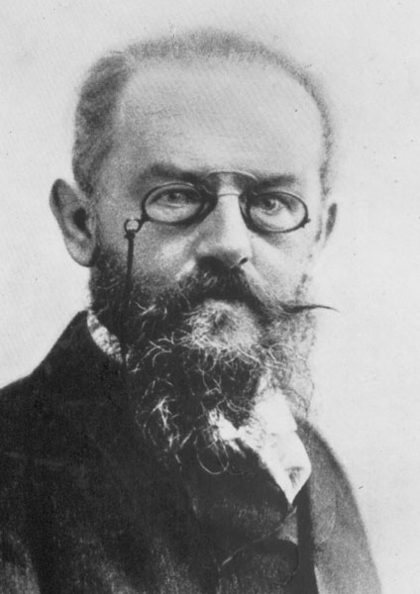
Bezold, Friedrich von

Slide 93
Bartolomeo Eustachius

Slide 94
Nathaniel Highmore

Slide 95
Maurice Cottle

Slide 96
Theodor Bilroth

Slide 97
William Maceven

Slide 98
St. Claire Tmompson

Slide 99
Sir Victor Ewings Negus

Slide 100
Dr.A. Mahadevaiah

Slide 101
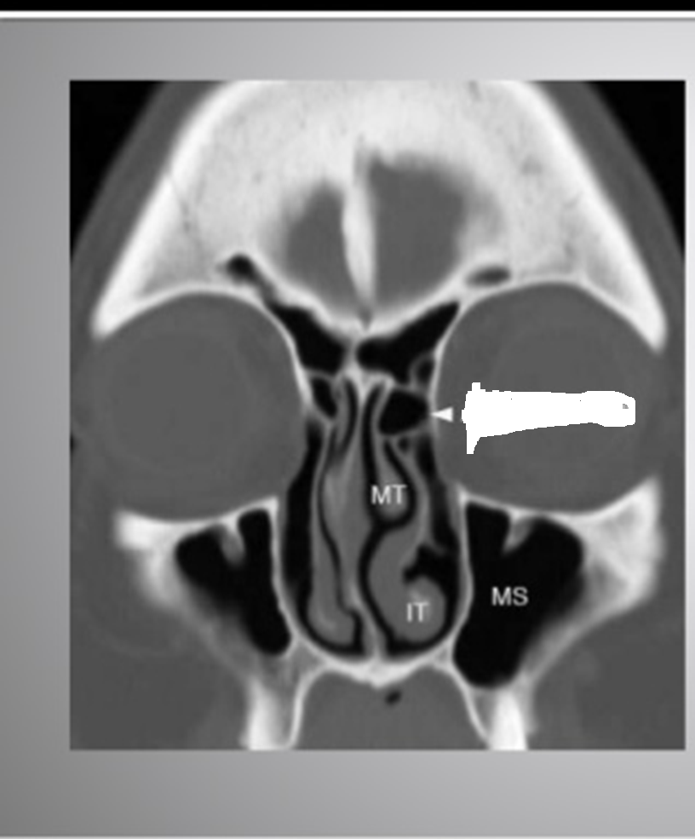
Agar Nasi Cell

Slide 102
Spheno-ethmoidal recess

Slide 103
Concha Bullosa

Slide 104
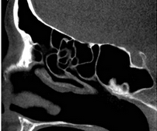
Which type of Sphenoid sinus
Pre-Sellar

Slide 105
What type of uncinate process: Hypertrophied

Slide 106
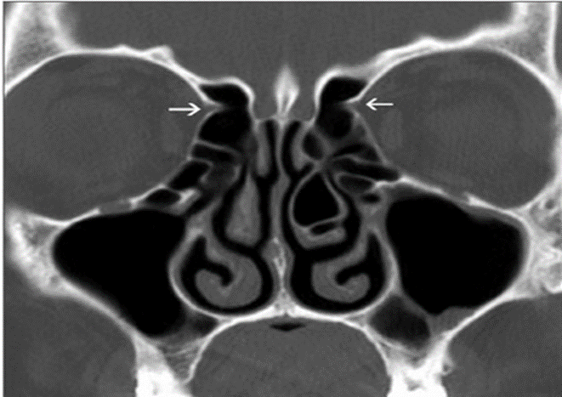

Slide 107
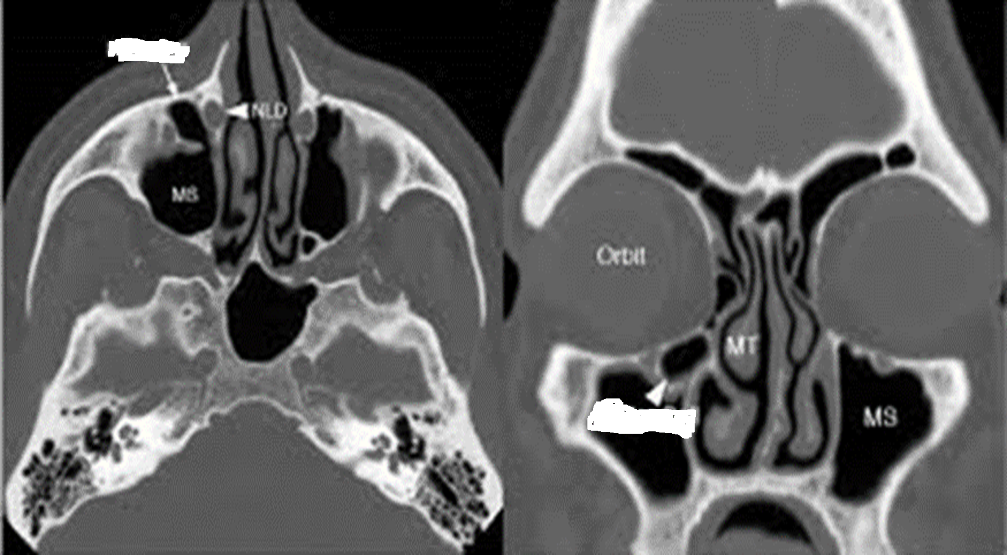
Hellar Cell

Slide 108
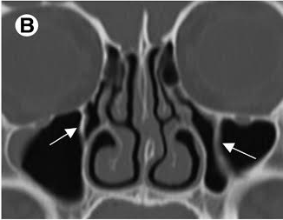
Septa in Maxillary sinus

Slide 109
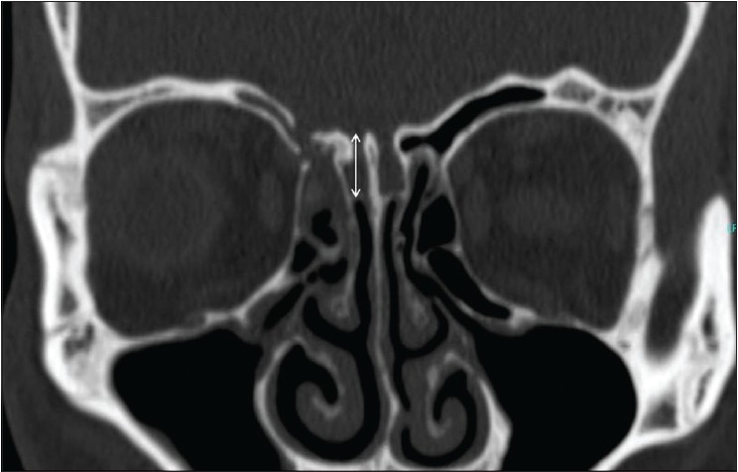
Keros type III

Slide 110
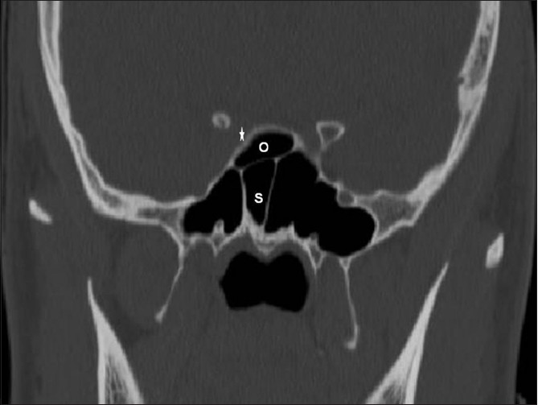
Onodi Cell

Slide 111
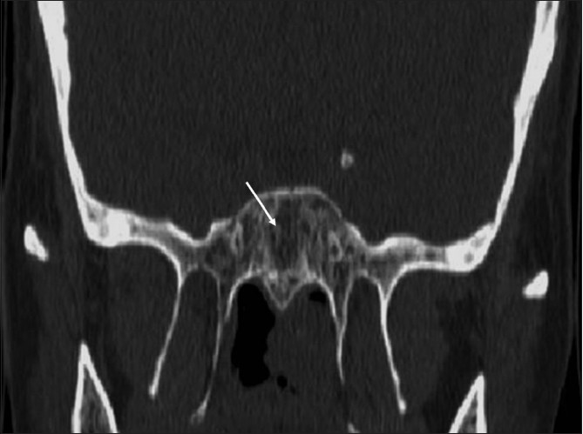
Agenesis of the sphenoid sinus

Slide 112
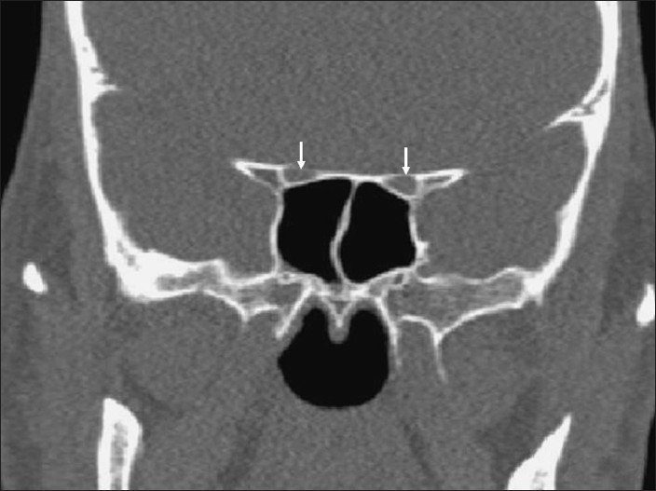
Optic Canals

Slide 113
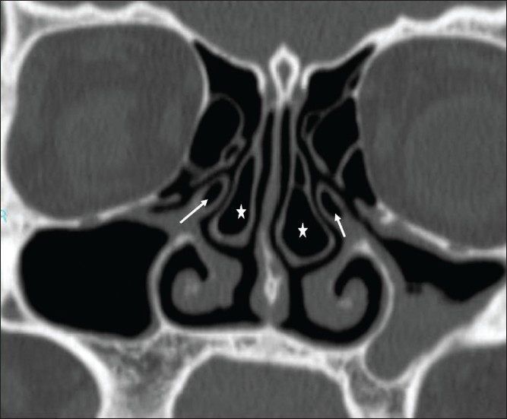
Pneumatization of Uncinate process

Slide 114
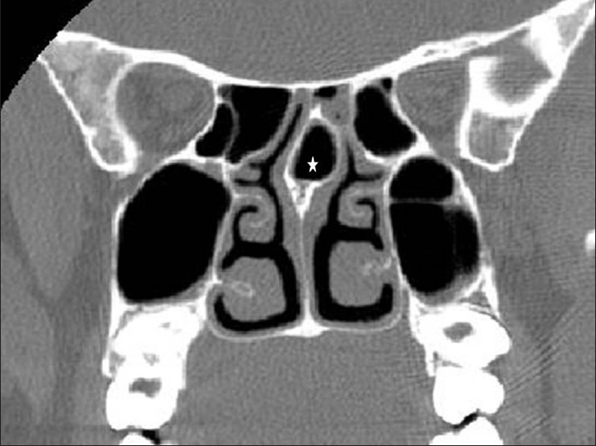
Pneumatization of posterior part of septum

Slide 115
Perichondritis

Slide 116
Diffuse Otitis Externa

Slide 117
Otomycosis

Slide 118
Ramsay Hunt Syndrome

Slide 119
Exostosis

Slide 120
Identify the lesion
NPA

Slide 121
Identify the lesion
Nasal Polyp

Slide 122
Spot the diagnosis: Biopsy of nasal mass
NPC

Slide 123
Inv Pap

Slide 124
Pleomorphic adenoma

Slide 133
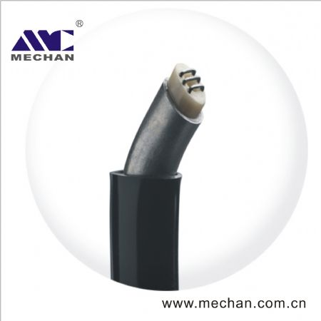
Plasma wand for Coblation

Slide 134
Type C

Slide 135
Rubin’s Septal Morselizer

Slide 136
Malleus Nipper

Slide 137
Laryngeal Mask Airway

Slide 138
Diagnostic and interventional Marchal Sialendoscope

Slide 140
What is full form of COMMANDO procedure
COMbined MAndibulectomy and Neck Dissection Operation

Slide 141
LASER
Light amplification by stimulated emission of radiation

Slide 142
CAPD
Central Auditory Processing Disorder

Slide 143
AHI
apnea-hypopnea index

Slide 144
PORP
partial ossicular replacement prosethesis

Slide 145
DPOAE
Distortion product otoacoustic emissions

